Slide 1
HTTP Communication
Testing HTTP Requests
Lecture 5
By James(Jin) Wang
12/25/2021

Slide 2
Outline
Consuming REST services
Retrieving data with resolvers
Creating interceptors
Caching data in your apps
Unit testing

Slide 3
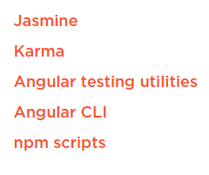
Testing HTTP Requests
  Default Angular Unit Testing Tools

Slide 4
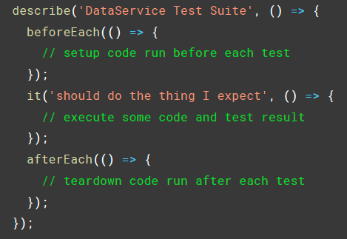
Testing HTTP Requests
  Structure of Jasmine Unit Tests

Slide 5
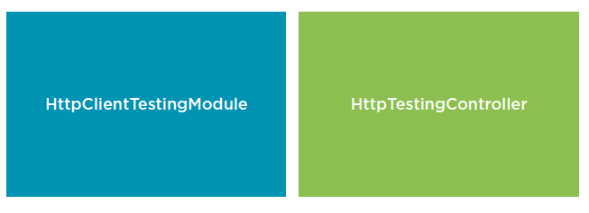
Testing HTTP Requests
  Angular HTTP Testing Utilities

Slide 6
Summary

Slide 7
Assignment

Slide 8
Self Study
  Angular HTTP Communication
  https://app.pluralsight.com/library/courses/angular-http-communication

